Slide 1

THE DYNAMIC LAYER
CHAPTER 05
‹#›

Slide 2
Topics
The Dynamic Layer
The Role of the Player
Emergence
Dynamic Mechanics
Dynamic Aesthetics
Dynamic Narrative
Dynamic Technology
‹#›

Slide 3
The Dynamic Layer
Once players start actually playing a game, it moves from the Inscribed Layer into the Dynamic Layer of the Layered Tetrad.
Play, strategy, and meaningful player choices all emerge in this layer.
‹#›

Slide 4
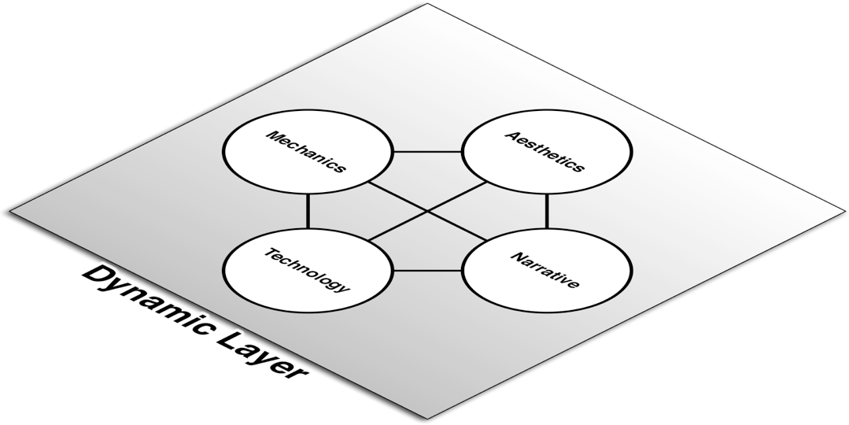

The Role of the Player
A game isn't a game unless someone is playing it
Other forms of media still exist without an audience
But a game is fundamentally altered by the participation of the player
Players move the game into the Dynamic Layer
Players
‹#›

Slide 5
Emergence
Simple rules beget complex behavior
Even simple rules can have complex implications
A tiny change to a rule can cause massive changes in these implications
"Change a number, and you change the game" – Chris Swain
Unexpected mechanical emergence
Sometimes unexpected dynamic mechanics will emerge from inscribed mechanical rules
The designer is responsible for knowing the range of emergent possibilities created by her rules
Playtesting is a critical tool for helping the designer discover this range
‹#›

Slide 6
The Dynamic Layer: Mechanics
Six aspects of Dynamic Mechanics
Procedures
The actions taken by the players during the game
Meaningful Play
Are game actions discernible and integrated?
Strategy
A calculated set of actions to help a player achieve her goal
House Rules
Occur when players make small alterations to the inscribed rules
Player Intent
What is each individual player's goal? How does it affect the game?
Outcome
What is the result of playing the game?
‹#›

Slide 7
The Dynamic Layer: Mechanics
Procedures
Inscribed rules are instructions from the developers to players about how to play the game
Procedures are the actual actions taken by the players, which are prescribed by the rules
Examples:
Passing GO and collecting $200 in Monopoly
Bluffing in Poker – Though this is not specifically described in the rules of the game, it is a common procedure
‹#›

Slide 8
The Dynamic Layer: Mechanics
Meaningful Play
In Rules of Play, Katie Salen and Eric Zimmerman define "meaningful play" as actions that are both discernible and integrated
Discernible - The player can tell that the game has reacted to her action
When I push the call button for an elevator, it lights up
Integrated - The player knows that her action is affecting the overall outcome of the game
Because I pushed the call button, the elevator will come to this floor
If actions do not appear to the players to be meaningful, players can often lose interest in the game
‹#›

Slide 9
The Dynamic Layer: Mechanics
Strategy
Plans made by the player to achieve her goal
Her goal does not have to be winning the game
When playing with a small child, many player's goal would be for the child to have fun
Optimal Strategy
Some games are so simple that a single strategy has the highest likelihood of winning
Tic-Tac-Toe is so simple that chickens have been taught to play it and either win or draw every time
Most games are complex enough to not have a true optimal strategy
Designing for Strategy
Provide the player with multiple ways to win
Create relationships between these possible ways of winning
Make some complementary and others mutually exclusive
‹#›

Slide 10
The Dynamic Layer: Mechanics
House Rules
Players make small modifications to the inscribed rules
Most often happen in board and paper games
Can be intentional or unintentional
If your inscribed rules are unclear, players may unintentionally create house rules
Many player's first foray into game design!
‹#›

Slide 11
The Dynamic Layer: Mechanics
Player Intent
The dynamic game experience is shaped by the intents of the players in the game
John Bartle's four types of players who suit MUDs
Achiever (Diamond): Seeks to get the highest score in the game. Wants to dominate the game.
Explorer (Spade): Seeks to find all the hidden places in the game. Wants to understand the game.
Socializer (Heart): Wants to play the game with friends. Wants to understand the other players.
Killer (Club): Wants to provoke other players of the game. Wants to dominate the other players.
‹#›

Slide 12
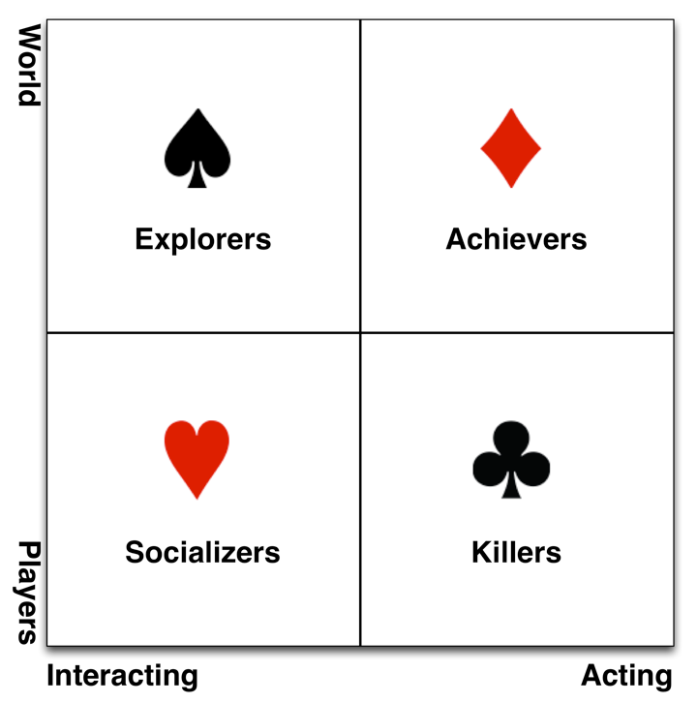
The Dynamic Layer: Mechanics
Bartle's types in a 2x2 continuum
‹#›

Slide 13
The Dynamic Layer: Mechanics
Player Intent
The dynamic game experience is shaped by the intents of the players in the game
John Bartle's four types of players who suit MUDs
Achiever (Diamond): Seeks to get the highest score in the game. Wants to dominate the game.
Explorer (Spade): Seeks to find all the hidden places in the game. Wants to understand the game.
Socializer (Heart): Wants to play the game with friends. Wants to understand the other players.
Killer (Club): Wants to provoke other players of the game. Wants to dominate the other players.
Two types of players you don't want in your games
Cheater - Wants to win. Doesn't care about integrity of the game.
Spoilsport - Doesn't care about winning. Wants to ruin game.
‹#›

Slide 14
The Dynamic Layer: Mechanics
Outcome
Multiple layers of outcome:
Immediate - The immediate result of each action in the game
Quest - The result of having completed or failed a quest
Also often resolves a tiny narrative
Cumulative - The result of working toward a goal over time
Example: Gathering experience points until eventually leveling up
Final - The outcome that ends the game
Death is often not a final outcome
Some games (like pen and paper RPGs) often lack a final outcome
‹#›

Slide 15
The Dynamic Layer: Aesthetics
Dynamic Aesthetics emerge when playing the game
Two main categories:
Procedural Aesthetics
Aesthetics that are generated on the fly via programming
Environmental Aesthetics
The aesthetics of the environment in which the game is played
‹#›

Slide 16
The Dynamic Layer: Aesthetics
Procedural Aesthetics
Combinations of technology and inscribed aesthetics
Audio Example: Procedural Music
Three types:
Horizontal Re-Sequencing - Rearranges several precomposed sections of music
Example: LucasArts' iMUSE system in X-Wing
Vertical Re-Orchestration - Various tracks of music are enabled or disabled to lend various voices to the music and change feel
Examples: PaRappa the Rapper and Frequency
Procedural Composition - Music is actually composed on the fly by the programming code based on the situation in the game
Examples: CPU Bach and the procedural music in Flower
‹#›

Slide 17
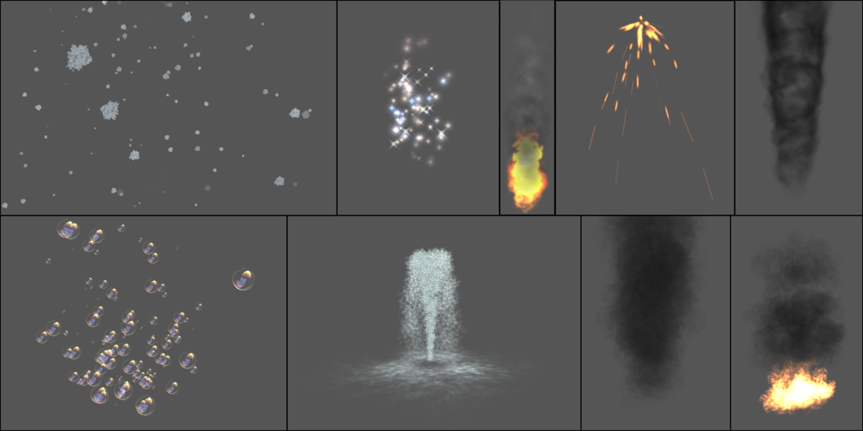
The Dynamic Layer: Aesthetics
Procedural Aesthetics
Combinations of technology and inscribed aesthetics
Audio Example: Procedural Music
Visual Examples
Particle Systems - Seen in almost every game
‹#›

Slide 18
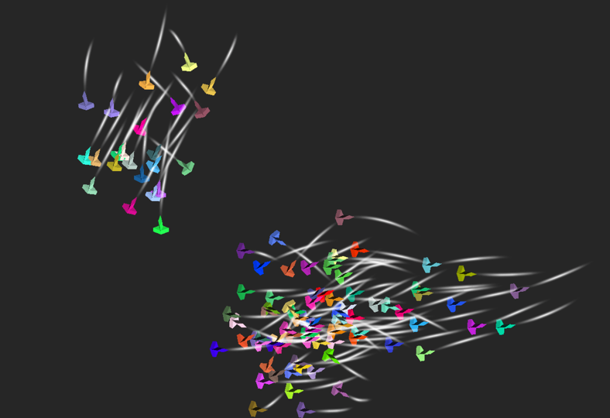
The Dynamic Layer: Aesthetics
Procedural Aesthetics
Combinations of technology and inscribed aesthetics
Audio Example: Procedural Music
Visual Examples
Particle Systems - Seen in almost every game
Procedural Animation - Code moves or animates game elements
Examples: Boids and the creatures in Spore
‹#›

Slide 19
The Dynamic Layer: Aesthetics
Environmental Aesthetics
The play environment will always dynamically affect the gameplay experience
Visual Play Environment
Brightness of the environment vs. screen
Resolution of the player's screen
Auditory Play Environment
Noisy environments
Players can lower or mute volume
Player Considerations
Colorblindness - 7-10% of men have a form of colorblindness
Epilepsy and Migraines - Both can be caused by flashing or flickering images
‹#›

Slide 20
The Dynamic Layer: Narrative
Dynamic Narrative occurs as the game is played
Two major types
Interactive Fiction - An inscribed story that adapts to choices made by the player
Emergent Narrative - The player's story of her experience playing the game
‹#›

Slide 21
The Dynamic Layer: Narrative
Interactive Fiction - An inscribed story that adapts to choices made by the player
Janet Murray wrote about the nascent forms of interactive fiction in her book Hamlet on the Holodeck
IF is unique because it happens to the player
From Zork (1979)
You [descend through the trap door into] a dark and damp cellar with a narrow passageway leading east and a crawlway to the south. To the west is the bottom of a steep metal ramp which is unclimbable. The door crashes shut, and you hear someone barring it.
In IF relationships are developed through shared experience
This is also how relationships are developed in actual life
Examples: Planetfall and Ico
‹#›

Slide 22
The Dynamic Layer: Narrative
Emergent Narrative - The player's story of her experience playing the game
By playing games, players develop their own narratives
This is very common in pen & paper Roleplaying Games
It is one of the major reasons that people play paper RPGs
In a paper RPG, a major job of the Game Master is to craft a compelling story for the players and to adapt the story to their needs, wants, and fears
Example: The story of the Balrog and the Rod of Splendor from the chapter
‹#›

Slide 23
The Dynamic Layer: Technology
The runtime, in-game behavior of both paper and digital technologies
Paper Technologies
The true behavior of paper technologies vs. their theoretical behavior
Example: In a certain game session, a six is rarely rolled on 2d6, even though probability states that 6 should be rolled in 5/36 rolls of 2d6
Chapter 11, "Math and Game Balance" covers probability
Digital Technologies
The execution of all computer code occurs in the dynamic layer
Includes:
Strategies developed by technology: Artificial Intelligence
Execution of any game code
Underlying execution of non-game code: Operating System
‹#›

Slide 24
Chapter 5 – Summary
The four elements of the Dynamic Layer encompass everything that happens as the game is played
Ownership over the the Dynamic Layer is shared between the developers and the players
Once players have played a game, the aftermath of that play becomes the Cultural Layer
The topic of the next chapter
‹#›

